Slide 1

IMAGE CAPTION GENERATOR
Batch 275
180030769-Ch.Sai Keerthana

Slide 2
Contents
Abstract
Aim
Data Set
Project Pipeline
Working
CNN
LSTM
System Requirements
Advantages
Conclusion

Slide 3
Abstract
Image caption generator is a process of recognizing the context of an image and annotating it with relevant captions using deep learning, and computer vision. It includes the labeling of an image with English keywords with the help of datasets provided during model training. Imagenet dataset is used to train the CNN model called Xception. Xception is responsible for image feature extraction. These extracted features will be fed to the LSTM model which in turn generates the image caption.

Slide 4
Aim
In this Project we are going to develop an image caption generator using CNN and LSTM for generating a suitable caption for the image.

Slide 5
DataSet
Flickr 8K_Dataset
https://www.kaggle.com/adityajn105/flickr8k
Flickr8k_text
https://bit.ly/2DcBAgF

Slide 6
Project Pipeline
1.Load the require Dataset
2.Explore and visualize the data
3.Pre-Processing the data
4.Developing a design model for CNN and LSTM
5.Testing the results
6.Analyzing the model Accuracy

Slide 7
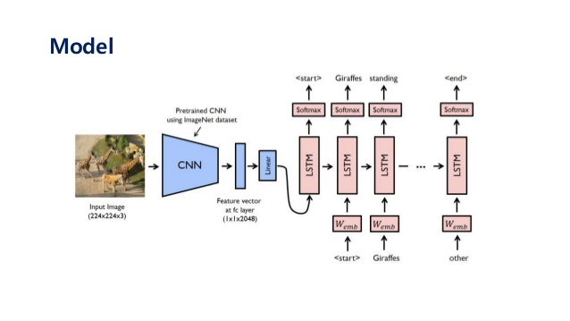
Working

Slide 8
CNN
A Convolutional Neural Network (CNN) is a type of Deep Neural Network which driven from biologically driven model. It is used in image recognition and processing that is specifically designed to process the pixel data.
Convolutional layers are set of filters applied to given image. A convolution converts all the pixels in its receptive field into a single value.
Pooling layer is a kind of down sampling layer which is used to reduce the dimensions of the features in the input image taken.
This cycle takes place until it reach Fully Connected Layer.
A Fully connected layer is the layer where each and every node is connected to the other in the acquisition.

Slide 9
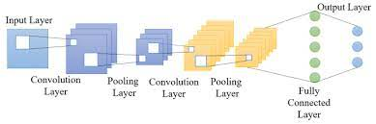
CNN Architecture

Slide 10
Long Short-Term Memory(LSTM)
Long Short-Term Memory(LSTM) networks are a type of Recurrent Neural Network (RNN) capable of learning order dependence in sequence prediction problems. This is most commonly used in complex problems like Image Caption Generation, Speech Recognition, Hand-writing recognition

Slide 11
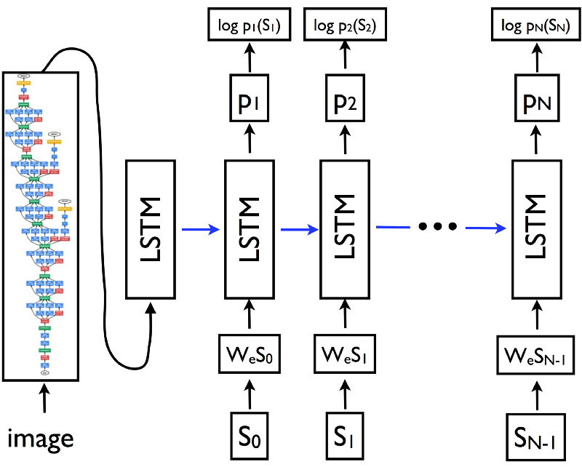
LSTM Architecture

Slide 12
System requirements
Processor: intel core i3 or High
RAM: 4GB
Language: Python 3.7
Software: Anaconda – Jupyter Notebook

Slide 13
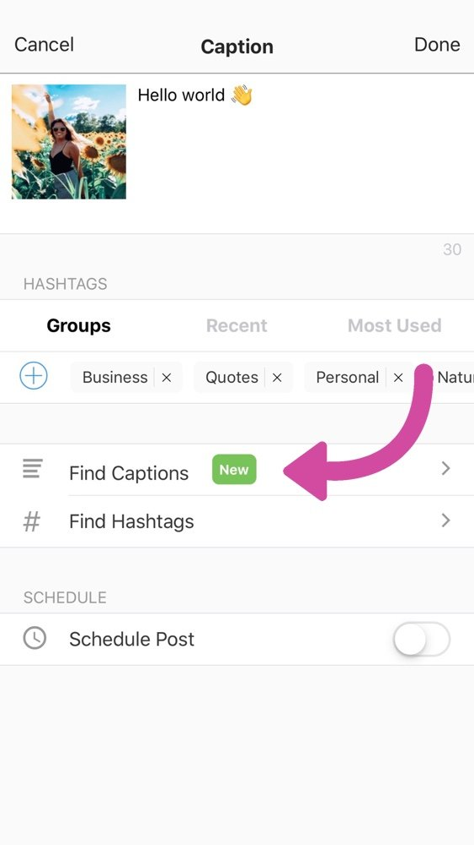
Advantages
It is can be used for assisting visually Impaired people.
It can be used in virtual assistant bots
Social media app Instagram also use image caption generator for captioning images

Slide 14
Conclusion
In this project we have developed an image caption generator using CNN and LSTM for accurate prediction of caption for images provided by users. The main objective behind the development of this project is to help the visually impaired people is made possible

Slide 15


